Slide 1

Computer Systems Fundamentals
H175 34
Lecture 1
Numbers in bases 10 and 2

Slide 2
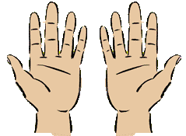
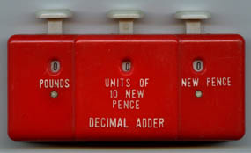
How Humans Count
We are used to counting in “lots”, or bases, of 10. This is called decimal or denary.
If I didn't have 10 fingers,
I couldn't count to 10...
I always use my fingers,
They're better than a pen!

Slide 3


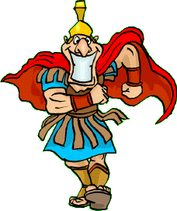
The denary numbers we normally use are written in base 10. But this was not always the case!
The Ancient Babylonians used a sexagesimal, or 60, number base….
…the ancient Egyptians used 12s….
…and the Romans did not use number bases at all! So although they were good at building, painting and administration, they never developed complex mathematical systems as the Greeks and Arabs did.

Slide 4


How Computers Count
Computer circuits are formed from millions of tiny switches – nowadays these are made from transistors and capacitors (early computers used valves or metal plates).
Everything a computer stores or manipulates must therefore be reduced to a series of switches, which are either …. or……
On = 1
Off = 0

Slide 5
Two-state Systems
Because computers can only recognise two states, this gives us the term “binary” – from the Latin bi-, meaning “two”.
Each switch is called a “bit” – from the terms
binary and digit.
They must store and accomplish everything they do using just two states.

Slide 6
Storing Numbers
To begin, we will see how to store simple integer numbers in a binary format.
If we begin with one switch, or bit, we can count up to 1. The switch can either be OFF- representing 0 – or ON, representing 1.
=0
If we want to count higher than 1, we have to add an extra bit….
=1

Slide 7
Two switches, or bits, enable us to count up to 3.
Zero -
Working from the right, the first bit represents lots of 1, or 2⁰.
The second bit represents lots of 2, or 2¹.
One -
Two -
If we added a third bit on the left, it would represent lots of 4, or 2².
Three -

Slide 8
We can build up a table of bits, and what each one is worth, depending on it’s place in the row.
^{Column Number} | ¹⁰ | ⁹ | ⁸ | ⁷ | ⁶ | ⁵ | ⁴ | ³ | ² | ¹
^{Power} | 2⁹ | 2⁸ | 2⁷ | 2⁶ | 2⁵ | 2⁴ | 2³ | 2² | 2¹ | 2⁰
^{Value} | 512 | 256 | 128 | 64 | 32 | 16 | 8 | 4 | 2 | 1
If all the bits were set to 1 in the 10-bit storage above, the whole number would be worth 1023 – i.e. 512+256+128+64+32+16+8+4+2+1!
Another way of calculating this would be –
(2¹⁰ – 1), or (1024 – 1), = 1023.

Slide 9

What are the valves doing?
To work out what a binary value is worth in base 10, or denary, we can start with the table we just saw –
^{Column Number} | ¹⁰ | ⁹ | ⁸ | ⁷ | ⁶ | ⁵ | ⁴ | ³ | ² | ¹
^{Power} | 2⁹ | 2⁸ | 2⁷ | 2⁶ | 2⁵ | 2⁴ | 2³ | 2² | 2¹ | 2⁰
^{Value} | 512 | 256 | 128 | 64 | 32 | 16 | 8 | 4 | 2 | 1
And line up the digits in the correct places…..
1 | 0 | 1 | 1 | 1 | 0 | 0 | 1 | 1 | 0

Slide 10
^{Column Number} | ¹⁰ | ⁹ | ⁸ | ⁷ | ⁶ | ⁵ | ⁴ | ³ | ² | ¹
^{Power} | 2⁹ | 2⁸ | 2⁷ | 2⁶ | 2⁵ | 2⁴ | 2³ | 2² | 2¹ | 2⁰
^{Value} | 512 | 256 | 128 | 64 | 32 | 16 | 8 | 4 | 2 | 1
^{Binary Number} | 1 | 0 | 1 | 1 | 1 | 0 | 0 | 1 | 1 | 0
Our number is worth 512+128+64+32+4+2 = 742.
0 | 0 | 1 | 0 | 1 | 1 | 0 | 0 | 1 | 1
What is the value of this one?

Slide 11
Convert Decimal to Binary
You will also be required to convert numbers in a denary base – base 10 – to binary. The question will tell you how many bits of storage to use.
Example – convert 935 to binary using 12 bit storage.
^{Column Number} | ¹² | ¹¹ | ¹⁰ | ⁹ | ⁸ | ⁷ | ⁶ | ⁵ | ⁴ | ³ | ² | ¹
^{Power} | 2¹¹ | 2¹⁰ | 2⁹ | 2⁸ | 2⁷ | 2⁶ | 2⁵ | 2⁴ | 2³ | 2² | 2¹ | 2⁰
^{Value} | 2048 | 1024 | 512 | 256 | 128 | 64 | 32 | 16 | 8 | 4 | 2 | 1

Slide 12
^{Column Number} | ¹² | ¹¹ | ¹⁰ | ⁹ | ⁸ | ⁷ | ⁶ | ⁵ | ⁴ | ³ | ² | ¹
^{Power} | 2¹¹ | 2¹⁰ | 2⁹ | 2⁸ | 2⁷ | 2⁶ | 2⁵ | 2⁴ | 2³ | 2² | 2¹ | 2⁰
^{Value} | 2048 | 1024 | 512 | 256 | 128 | 64 | 32 | 16 | 8 | 4 | 2 | 1
1
1
1
1
1
1
1
Our original number was 935. We can get one “lot” of 512 out of that, leaving
(935 – 512) = 423…
423 gives us enough to make 1 lot of 256, leaving 167 over….
From 167 we can take 128, leaving 39…
There’s not enough to make a 64, but we’ll get 32, leaving 7….
The remaining 7 will make a 4, a 2 and a 1.

Slide 13
^{Column Number} | ¹² | ¹¹ | ¹⁰ | ⁹ | ⁸ | ⁷ | ⁶ | ⁵ | ⁴ | ³ | ² | ¹
^{Power} | 2¹¹ | 2¹⁰ | 2⁹ | 2⁸ | 2⁷ | 2⁶ | 2⁵ | 2⁴ | 2³ | 2² | 2¹ | 2⁰
^{Value} | 2048 | 1024 | 512 | 256 | 128 | 64 | 32 | 16 | 8 | 4 | 2 | 1
 | 0 | 0 | 1 | 1 | 1 | 0 | 1 | 0 | 0 | 1 | 1 | 1
^{Column Number} | ¹² | ¹¹ | ¹⁰ | ⁹ | ⁸ | ⁷ | ⁶ | ⁵ | ⁴ | ³ | ² | ¹
^{Power} | 2¹¹ | 2¹⁰ | 2⁹ | 2⁸ | 2⁷ | 2⁶ | 2⁵ | 2⁴ | 2³ | 2² | 2¹ | 2⁰
^{Value} | 2048 | 1024 | 512 | 256 | 128 | 64 | 32 | 16 | 8 | 4 | 2 | 1
 |  |  | 1 | 1 | 1 |  | 1 |  |  | 1 | 1 | 1
Now we fill in the remaining spaces with zeroes, which do not affect the value in any way.
Our number, 935, would be stored in 12 bit binary as
001110100111.
You may sometimes see this written as
001110100111₂ - to denote that this is a binary, or base 2, number.

Slide 14
^{Column Number} | ¹² | ¹¹ | ¹⁰ | ⁹ | ⁸ | ⁷ | ⁶ | ⁵ | ⁴ | ³ | ² | ¹
^{Power} | 2¹¹ | 2¹⁰ | 2⁹ | 2⁸ | 2⁷ | 2⁶ | 2⁵ | 2⁴ | 2³ | 2² | 2¹ | 2⁰
^{Value} | 2048 | 1024 | 512 | 256 | 128 | 64 | 32 | 16 | 8 | 4 | 2 | 1
Using the table above convert the decimal number
1365
into 12bit binary

Slide 15
The Answer is: 010101010101

Slide 16
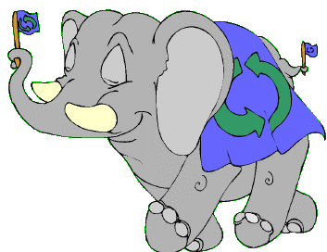
The Dividing Method
Another method of converting Denary numbers to Binary is dividing by two, and counting the remainders.
However, this method can get messy for larger numbers!

Slide 17

The Number 375 converted…
375 divided by 2 is 187 r 1
187 divided by 2 is 93 r 1
93 divided by 2 is 46 r 1
46 divided by 2 is 23 r 0
23 divided by 2 is 11 r 1
11 divided by 2 is 5 r 1
5 divided by 2 is 2 r 1
2 divided by 2 is 1 r 0
1 divided by 2 is 0 r 1
We can then write down our new binary number simply by taking each remainder reading from the bottom up.
375₁₀ is 101110111₂
If the number ends in 1, it’s odd. If it ends in 0, it’s even.

Slide 18
Work out the number 211 in 8-bit storage.
^{Column Number} | ⁸ | ⁷ | ⁶ | ⁵ | ⁴ | ³ | ² | ¹
^{Power} | 2⁷ | 2⁶ | 2⁵ | 2⁴ | 2³ | 2² | 2¹ | 2⁰
^{Value} | 128 | 64 | 32 | 16 | 8 | 4 | 2 | 1
1 | 1 | 0 | 1 | 0 | 0 | 1 | 1
The answer is 11010011.
What is the highest integer number that would fit in 8 bits?
What do you think would happen if we tried to store a number bigger than that?

Slide 19
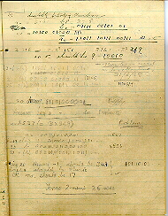
Early Programming
This is part of a program written for one of the first electronic computers, the Manchester Mark 1, in 1948.
In those days all of the programming was done in binary. This was very tedious and prone to lots of errors!

Slide 20
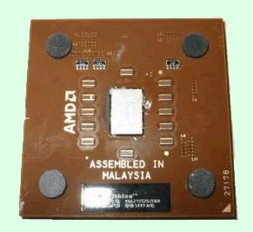
Modern Processors
The average modern processor uses about 85 million transistors and capacitors to store and manipulate binary values.
Modern computing on a 32-bit platform can handle integers up to 4,294,967,295 i.e. (2³² – 1).
The latest 64-bit AMD processors can go up to
18,446,744,073,709,551,615!

Slide 21
Convert the following….
309₁₀ to binary
27₁₀ to binary
295₁₀ to binary
1011 to decimal
11010 to decimal
1010100 to decimal
100110101₂
11011₂
100100111₂
11₁₀
26₁₀
84₁₀

Slide 22
Bits and Bytes
1 binary digit = 1 bit
8 binary digits = 1 byte
1024 bytes = 1 kilobyte

Slide 23

Any Questions?

Slide 24

Summary
Computers can only recognise two states.
A switch, or bit, cannot be between states.
The time delay for transition between states is negligible.
Anything stored or manipulated by computers must be held as some combination of 1s and 0s.
To store simple integers, computers use a binary or base 2 format.
They can store values up to (2^{number of bits} – 1).
You can convert between Binary and Denary using either the columns or dividing method.
If the number ends in 1, it’s odd. If it ends in 0, it’s even.

Slide 25

Credits
10 fingers and poem © mathstory.com
Decimal adder © Dave Rendell 2006
Binary Program © University of Machester
AMD Processor © Chrissie Nyssen 2002
All other graphics © Focus Multimedia with open licence, unless stated
All other contents © Aberdeen College 2010

